Slide 1
Capturing prediction uncertainty in upstream cell culture models using conformal prediction and Gaussian processes
Tien Dung Pham ^{1,2} Uwe Aickelin ¹ Robert Bassett ²
¹ School of Computing and Information Systems, The University of Melbourne, Victoria, Australia
² CSL Innovation Pty Ltd, Victoria, Australia
Highlights
First application of XGBoost-based cross-conformal regressors in upstream cell culture modelling
Proposing individualized coverage-width criterion (iCWC) as a combined metric for interval quality
Quantifying aleatoric uncertainty of the bioprocess using simulated data and conformal intervals

Slide 2
Uncertainty in upstream cell culture bioprocessing (USP)
Input / Design-of-Experiment (DoE)
Process
Output
Process uncertainty: for the same DoE, a process is likely to yield different outputs (aleatoric).
➔ Models should output interval-valued predictions with uncertainty.
To what extend does process uncertainty contribute to model prediction uncertainty?
Presented by TD Pham, U Aickelin and R Bassett at COPA 2023
Notes:
In other words, if a model predicts the yield to be between a range of [a, b]; how much of that range is the natural biological variation of the process? And how much of that range is the reducible epistemic uncertainty caused by a lack of knowledge or data?

Slide 3
Datasets
Given a real dataset $A$ with $E⊂A$ as the predictor variables (DoE) and $y∈A$ (VCD) as the target variable with 74 “runs”.
Each “run” instance refers to a subset of $A$ with the same $E$ and time point $t$ which ranges from $0$ to $12$. For each time point $t$ there is an associated $y$.
$A$ is reserved as test dataset. We simulated a train dataset $D$ using a MCMC scheme as follows:
Each run instance $\left(E_{i},t_{0…12} \right)$ was fitted using a 4-param mechanistic model.
10 best fitted parameter sets were used to generate 10 time series with the same $E_{i}$
The train dataset $D$ has 74 x 10 = 740 runs with 74 unique DoEs similar to those in $A$
Presented by TD Pham, U Aickelin and R Bassett at COPA 2023

Slide 4
Experiments
Task A
For $t ∈\{1, 2, …, 12\}$, predict $D_{i}\left(t\right)$ from DoE features and initial VCD value $D_{i}\left(0\right)$
This task is equivalent to predicting the whole VCD time series given the initial DoE
Task B
For $t ∈\{1, 2, …, 12\}$, predict $D_{i}\left(12\right)$ from DoE features and $\{D_{i}\left(t^{′}\right):t^{′}∈\{0,…,t\}\}$.
For example, when $t=3$, the task is to predict $D_{i}\left(12\right)$ from DoE features and $D_{i}\left(0\right),D_{i}\left(1\right),D_{i}\left(2\right),D_{i}\left(3\right)$.
This task is equivalent to predicting the yield VCD given the existing VCD measurements at any time point during the experiment.
Presented by TD Pham, U Aickelin and R Bassett at COPA 2023

Slide 5
Methods
Models:
Gaussian process regression (GPR) models
Cross-validation-plus conformal regressors (Barber et al., 2021) with a base XGBoost (XGB+CP).
Primary Evaluation Metric: Individualised Coverage-Width Criterion
$$iCWC=\frac{1}{n}\sum_{i=1}^{n}{\left(1+W_{i}\right)\left(1+𝕀_{\left\{y_{i}∉Q_{i}\right\}}e^{\min\left\{\left|y_{i}−Q_{i}^{U}\right|,\left|y_{i}−Q_{i}^{L}\right|\right\}}\right)}$$
Adapted from Coverage-width-based criterion (CWC) (Khosravi et al., 2011)
If a prediction interval $Q_{i}$ fails to cover the point $y_{i}$, iCWC will penalise the current interval width $W_{i}$ based on how close $Q_{i}$ was to cover the point $y_{i}$
Presented by TD Pham, U Aickelin and R Bassett at COPA 2023

Slide 6
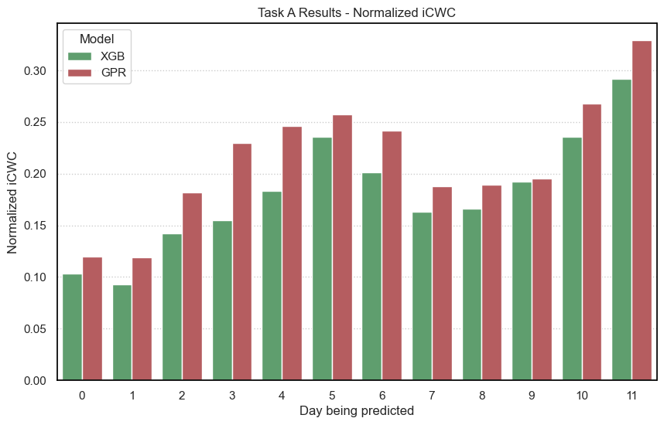
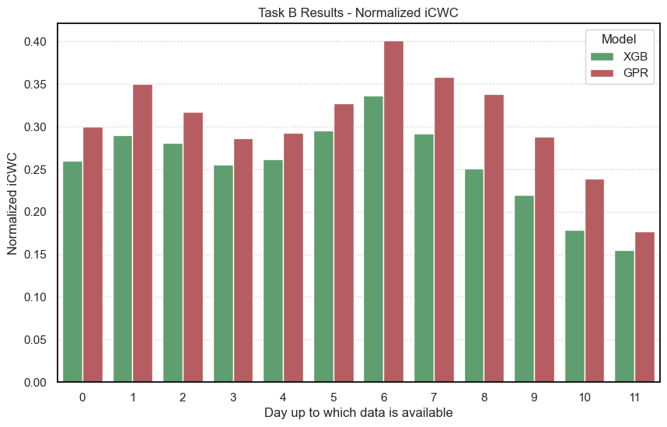
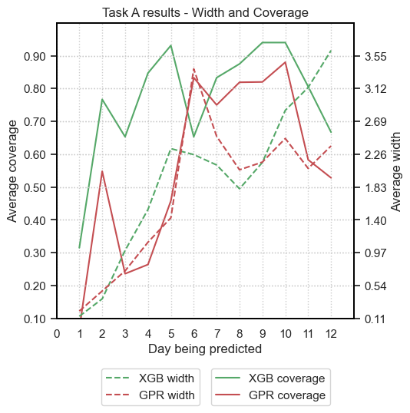
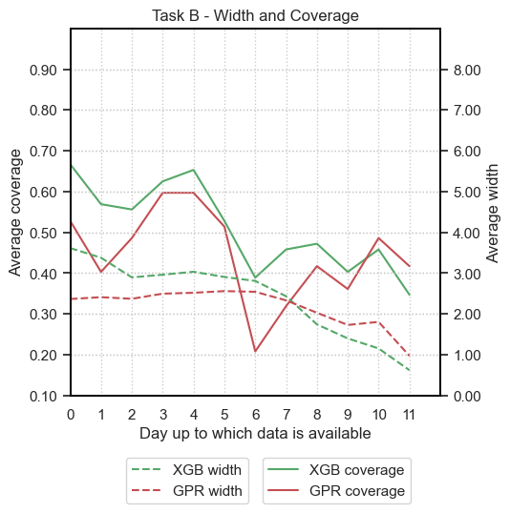
Results
XGB+CP outperformed the commonly used GPR in both prediction and UQ accuracies for the current experimental setup.
Both models failed to achieve the nominal coverage level, particularly when predicting the final yield based on initial conditions.
However, this discrepancy could be interpreted as the aleatoric process uncertainty.
Process interventions during the process introduced noises and uncertainties that both models could not adequately capture.
Presented by TD Pham, U Aickelin and R Bassett at COPA 2023

Slide 7
Future Works
Validate the frameworks on different datasets (including more hybrid-driven MCMC data simulators) and other bioprocess critical quality attributes such as antibody yield and cell viability
Quantify the process uncertainty by rigorous quantification of simulated model uncertainty
Improve on the data simulators and time-series models to account for mid-culture interventions to enhance the reliability of predictions
Investigate the possibility of using CCP with more complex bioprocess hybrid models
Presented by TD Pham, U Aickelin and R Bassett at COPA 2023

Slide 8
Presented by TD Pham, U Aickelin and R Bassett at COPA 2023

